Slide 1
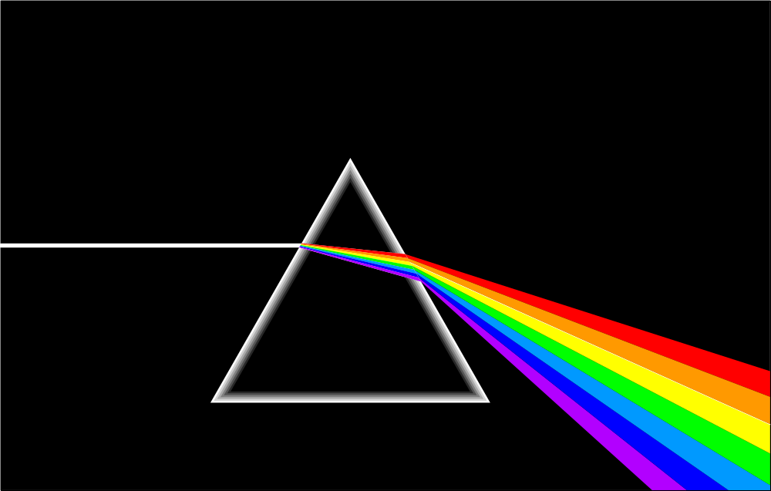
Waves
W Richards
Worthing High School

Slide 2
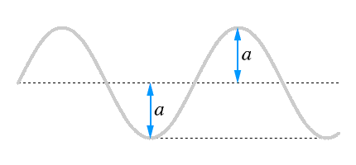
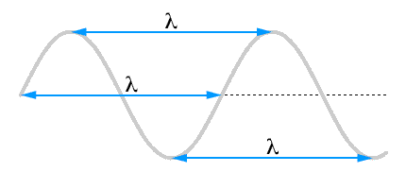
Some definitions…
1) Amplitude – this is “how high” the wave is:
2) Wavelength (λ) – this is the distance between two corresponding points on the wave and is measured in metres:
3) Frequency – this is how many waves pass by every second and is measured in Hertz (Hz)

Slide 3
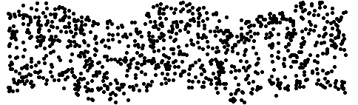



Some definitions…
Transverse waves are when the displacement is at right angles to the direction of the wave…
Longitudinal waves are when the displacement is parallel to the direction of the wave…

Slide 4
The Wave Equation
The wave equation relates the speed of the wave to its frequency and wavelength:
Wave speed (v) = frequency (f) x wavelength (λ)
in m/s in Hz in m
V
f
λ

Slide 5
Some example wave equation questions
A water wave travels through a pond with a speed of 1m/s and a frequency of 5Hz. How far apart are the waves?
The speed of sound is 330m/s (in air). When Ricky hears this sound his ear vibrates 660 times a second. What was the wavelength of the sound?
Purple light has a wavelength of around 6x10⁻⁷m. If its frequency is 5x10¹⁴ Hz what is the speed of light?
Red light travels at the same speed. Work out its frequency if its wavelength is about 4x10⁻⁷m.

Slide 6
Properties of Light
Light travels in straight lines:
Laser

Slide 7
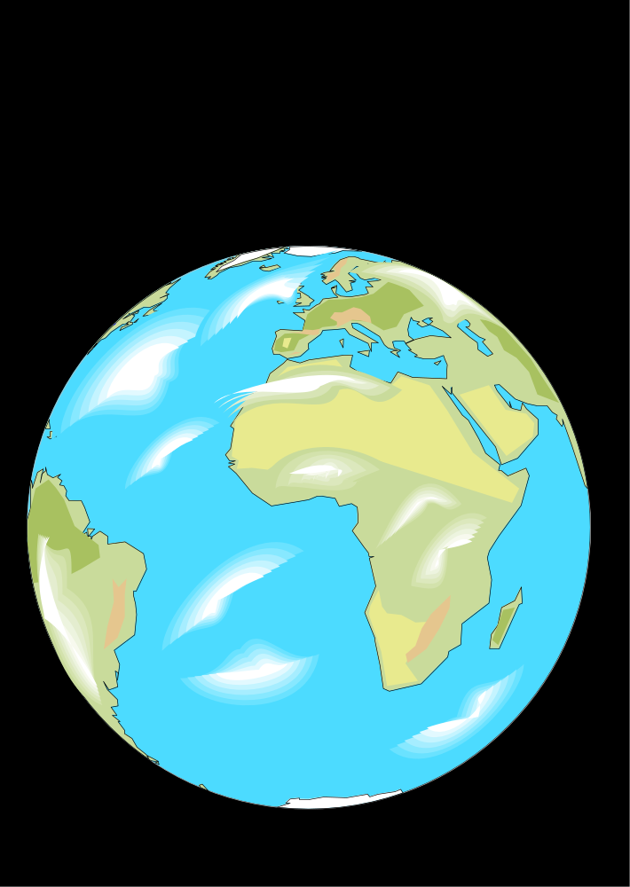
Light travels VERY FAST – around 300,000 kilometres per second.
At this speed it can go around the world 8 times in one second.

Slide 8

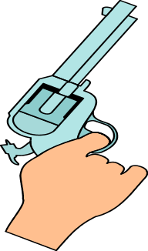
Light travels much faster than sound. For example:
Thunder and lightning start at the same time, but we will see the lightning first.
2) When a starting pistol is fired we see the smoke first and then hear the bang.

Slide 9
We see things because they reflect light into our eyes:
Homework

Slide 10
Luminous and non-luminous objects
A luminous object is one that produces light.
A non-luminous object is one that reflects light.
Luminous objects
Reflectors

Slide 11
Shadows
Shadows are places where light is “blocked”:
Rays of light

Slide 12
Reflection
Angle of incidence = Angle of reflection
Normal
Incident ray
Reflected ray
Angle of incidence
Angle of reflection
Mirror

Slide 13

Using mirrors
Two examples:
2) A car headlight
1) A periscope

Slide 14
Refraction through a glass block:
Wave slows down and bends towards the normal due to entering a more dense medium
Wave slows down but is not bent, due to entering along the normal
Wave speeds up and bends away from the normal due to entering a less dense medium

Slide 15
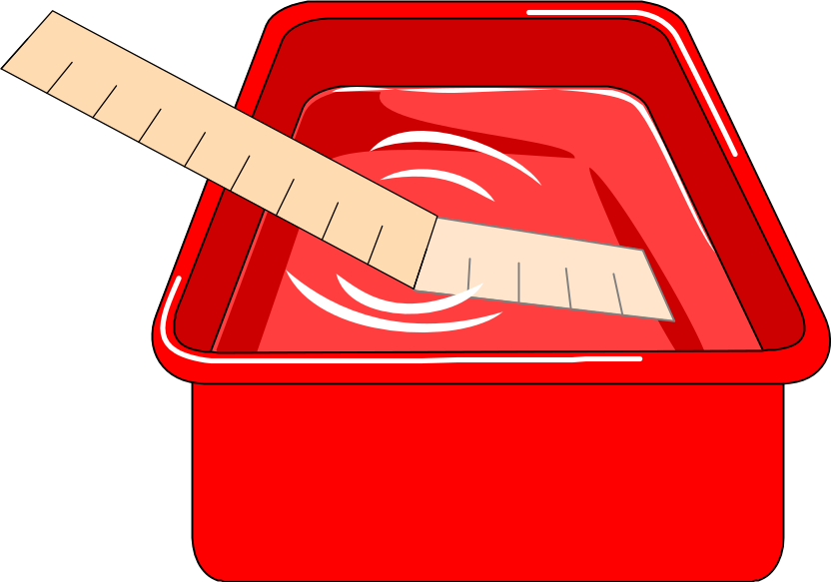

Slide 16
Refraction
Refraction is when waves ____ __ or slow down due to travelling in a different _________. A medium is something that waves will travel through. When a pen is placed in water it looks like this:
In this case the light rays are slowed down by the water and are _____, causing the pen to look odd. The two mediums in this example are ______ and _______.
Words – speed up, water, air, bent, medium

Slide 17
Finding the Critical Angle…
1) Ray gets refracted
2) Ray still gets refracted
4) Ray gets internally reflected
3) Ray still gets refracted (just!)
THE CRITICAL ANGLE

Slide 18
Uses of Total Internal Reflection
Optical fibres:
An optical fibre is a long, thin, _______ rod made of glass or plastic. Light is _______ reflected from one end to the other, making it possible to send ____ chunks of information
Optical fibres can be used for _________ by sending electrical signals through the cable. The main advantage of this is a reduced ______ loss.
Words – communications, internally, large, transparent, signal

Slide 19
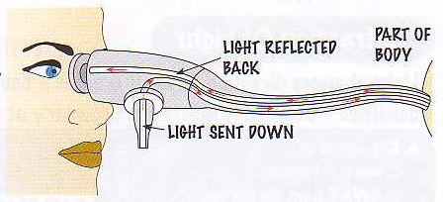
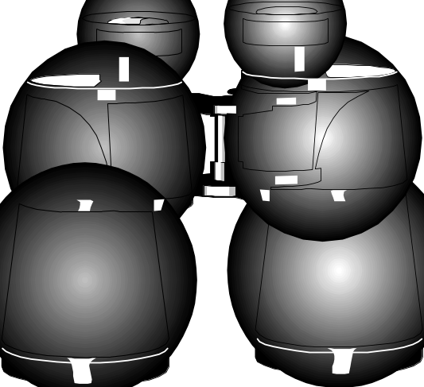
Other uses of total internal reflection
1) Endoscopes (a medical device used to see inside the body):
2) Binoculars and periscopes (using “reflecting prisms”)

Slide 20
Wave diagrams
1) Reflection
2) Refraction
3) Refraction
4) Diffraction

Slide 21
Diffraction
More diffraction if the size of the gap is similar to the wavelength
More diffraction if wavelength is increased (or frequency decreased)

Slide 22
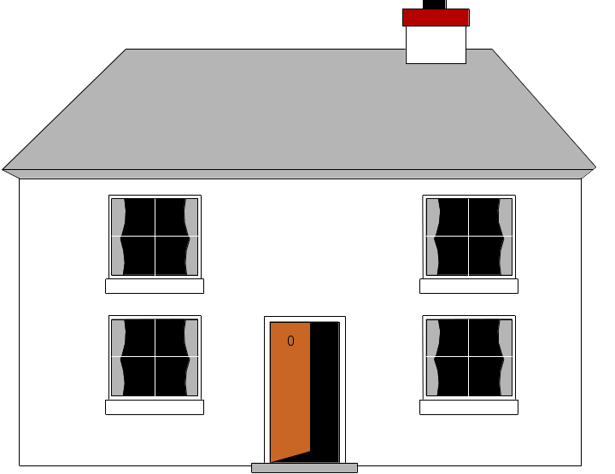
Sound can also be diffracted…
The explosion can’t be seen over the hill, but it can be heard. We know sound travels as waves because sound can be refracted, reflected (echo) and diffracted.

Slide 23
Diffraction depends on frequency…
A high frequency (short wavelength) wave doesn’t get diffracted much – the house won’t be able to receive it…

Slide 24
Diffraction depends on frequency…
A low frequency (long wavelength) wave will get diffracted more, so the house can receive it…

Slide 25
Deviation of Light
This happens because the light is refracted:
RED LIGHT is refracted THE LEAST
PURPLE LIGHT is refracted THE MOST

Slide 26
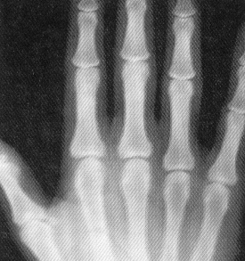




The electromagnetic spectrum
Each type of radiation shown in the electromagnetic spectrum has a different wavelength and a different frequency:
High frequency, _____ wavelength
Low frequency, _____ (high) wavelength
Gamma rays | X-rays | Ultra violet | Visible light | Infra red | Microwaves | Radio/TV
γ
Each of these types travels at the same speed through a _______ (300,000,000m/s), and different wavelengths are absorbed by different surfaces (e.g. infra red is absorbed very well by ___________ surfaces). This absorption may heat the material up (like infra red and _______) or cause an alternating current (like in a __ _______).
Words – black, microwaves, long, short, TV aerial, vacuum

Slide 27
Using an oscilloscope
1) Quiet sound, low frequency:
2) Quiet sound, high frequency:
3) Loud sound, low frequency:
4) Loud sound, high frequency:

Slide 28
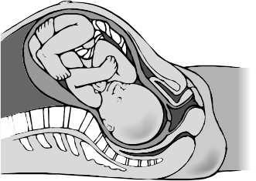


Ultrasound
Ultrasound is the region of sound above 20,000Hz – it can’t be heard by humans. There are a number of uses for ultrasound:
Pre-natal scanning
Cleaning – it can be used to dislodge dirt
Detecting flaws or cracks
Medical treatment

Slide 29



How does ultrasound work?
Ultrasonic waves are partly _________ at the boundary as they pass from one _______ to another. The time taken for these reflections can be used to measure the _______ of the reflecting surface and this information is used to build up a __________ of the object.
Words – depth, reflected, picture, medium

Slide 30
Transmitting information
As we said before, different types of electromagnetic radiation can be used to send different types of information, e.g. an optical fibre:
Optical fibres have two main advantages: they can send more information compared to electrical cables of the same diameter and with less signal weakening.
Another example is radio waves:
Ionosphere
The longer wavelength waves are transmitted by being reflected off the ionosphere (an electrically charged layer in the Earth’s atmosphere).

Slide 31
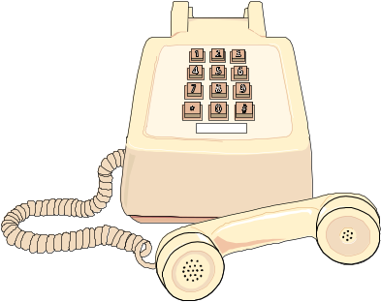
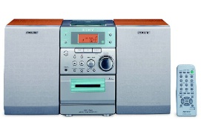
Transmitting information
Sounds can be transmitted long distances by converting them into electrical signals first:
A microphone converts ______ waves into electrical signals with the same amplitude and ________. These waves are then transmitted through cables where they are regularly _________ to reduce signal loss.
Radio waves can also be used as “carrier waves”:
Wave is demodulated back into a ____
Signal
____ wave
______ wave
Transmitter
Words – signal, frequency, modulated, carrier, sound, amplified

Slide 32
Analogue vs. Digital
Analogue signals (like talking or music) continually vary in amplitude and/or frequency
+
-
1
Digital signals, however, are either off or on, and the information is sent in a series of pulses
0
There are two main advantages of digital:
More information can be sent down the same cable
Better quality, because a digital signal can be amplified without amplifying the extra noise:

Slide 33
The Structure of the Earth
A thin crust - 10-100km thick
A mantle – has the properties of a solid but it can also flow
A core – made of molten nickel and iron. Outer part is liquid and inner part is solid
How do we know this? These facts have all been discovered by examining seismic waves (earthquakes)

Slide 34
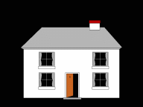

Seismic waves
Earthquakes travel as waves through the Earth – we call them SEISMIC WAVES. There are two types:
P waves:
They are longitudinal so they cause the ground to move up and down
They can pass through solids and liquids
They go faster through more dense material
S waves:
They are transverse so they cause the ground to move from right to left
They ONLY pass through solids
They are slower than P waves
They go faster through more dense material

Slide 35
Seismic waves
S waves will only travel through a solid
P waves travel through the Earth and are refracted when they pass through a medium
The paths of these waves are all curved because density is gradually changing
These observations tell us 3 things about the Earth: 1) It has a thin crust, 2) it has a semi-fluid mantle where density increases with depth, 3) a core with a liquid outer part and a solid inner part.

